Slide 1


Distributed Weather Data Processing and Trend Analysis REVIEW – 3
Team Members
Roll No Name
2320030207 A. Subash
2320030208 C. Saisandeep
2320030164 G. Rohith Sai
i
Department of Computer Science and Engineering
KONERU LAKSHMAIAH EDUCATION FOUNDATION

Slide 2
Outline
Abstract
Introduction
Proposed Method
Objectives
Module wise Implementations
Literature Survey
Implementation
Comparison and Discussion
Architecture
Module Design
Results
Conclusion

Slide 3
Abstract
In today's data-driven world, weather monitoring generates massive volumes of continuous data from thousands of global sensors and stations, demanding scalable and efficient processing systems beyond the capability of traditional centralized architectures. This project, "Distributed Weather Data Processing and Trend Analysis," presents a real-time Big Data web application that simulates a production-grade distributed pipeline where 8 global city nodes stream live weather data through Apache Kafka, which is then processed and analyzed by Apache Spark for anomaly detection and trend computation, stored in HDFS for distributed persistence, and visualized through an interactive dashboard built with React and Recharts - further enhanced by real-time live city-based weather analysis powered by the OpenWeatherMap API, making it a fully functional, scalable, and realistic Big Data solution.

Slide 4
Introduction
Weather data is one of the most continuously generated, high-volume datasets in the world, yet traditional centralized weather monitoring systems struggle to handle the massive scale, speed, and variety of data coming from multiple global sources simultaneously - leading to bottlenecks, data loss, and delayed insights. To solve this, we built Distributed Weather Data Processing and Trend Analysis, a real-time Big Data web application that collects live weather streams from 8 distributed global city nodes, processes them through a pipeline powered by Apache Kafka, Apache Spark, and HDFS, and visualizes trends, anomalies, and forecasts on an interactive dashboard - with real-time city-based weather analysis powered by the OpenWeatherMap API, making it a fully functional, scalable, and production-realistic Big Data solution.

Slide 5
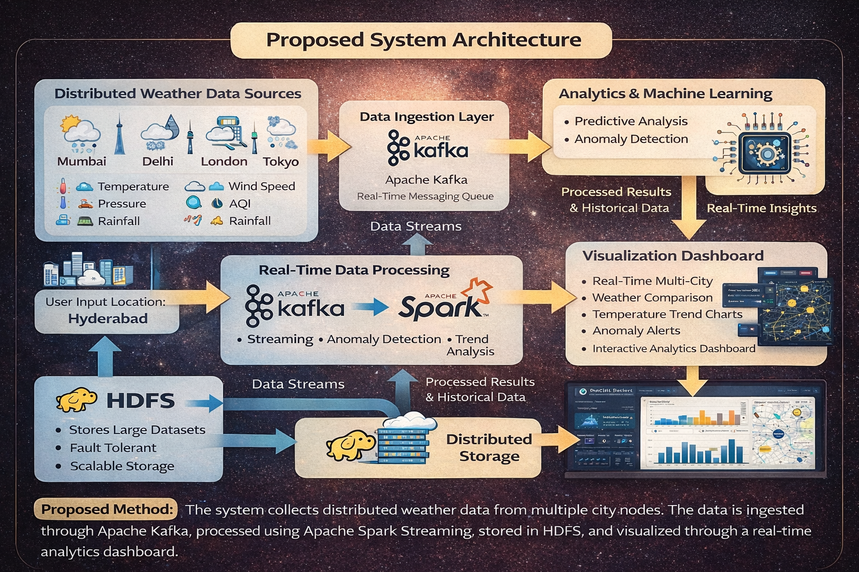
Proposed Method

Slide 6
Objectives
The main objectives of this project are:
To ingest real-time weather streams from 8 distributed global city nodes simultaneously
To detect weather anomalies like temperature spikes and pressure drops instantly
To visualize live trends, forecasts, and historical patterns through an interactive dashboard
To enable real-time location-based weather analysis for any city using OpenWeatherMap API.

Slide 7
Module-wise Implementations
Module 1: Log Data Collection Collect web server log file
Module 2: Data Pre-processing Clean and filter log data. Convert raw logs into structured format.
Module 3: Data Processing (Apache Spark)Process large log data using Spark. Analyze traffic, status codes, and user activity.
Module 4: Visualization Dashboard Visualize results using charts and graphs. Display traffic trends and error analysis.
Module 5: Anomaly Detection Detect unusual traffic and suspicious IP Activity. Identify error patterns and server issues.es (Apache/Nginx).Store log data in HDFS or local storage.

Slide 8
Literature Survey
Paper Title | Reference Link | Drawback | Future Work
Real-Time Weather Monitoring Using Distributed Systems | https://arxiv.org/abs/1709.03546 | High latency due to centralized data collection and lack of real-time stream processing. | Can be extended using distributed streaming frameworks like Kafka for low-latency ingestion.
Apache Spark for Large-Scale Weather Data Processing | https://arxiv.org/abs/1802.00316 | Requires high memory resources and complex cluster configuration for weather datasets. | Optimization using cloud-based deployment and auto-scaling Spark clusters.
Big Data Analytics for Climate and Weather Patterns | https://ieeexplore.ieee.org/document/7488251 | Limited to historical data analysis and lacks real-time anomaly detection capabilities. | Integration with live weather streams for dynamic trend and anomaly analysis.
Distributed Sensor Data Processing Using Hadoop | https://www.sciencedirect.com/science/article/pii/S1877050917322094 | Scalability issues when handling high-velocity data from multiple sensor nodes simultaneously. | Adoption of distributed streaming platforms for continuous weather data ingestion.
Weather Anomaly Detection Using Machine Learning | https://link.springer.com/article/10.1007/s00521-020-04762-8 | Complex model design and high computational cost for real-time anomaly classification. | Simplified architectures with intelligent real-time anomaly detection and severity classification.

Slide 9
Paper Title | Reference Link | Drawback | Future Work
Log Mining for Web Usage Analysis | https://ieeexplore.ieee.org/document/611314 | Limited ability to handle large-scale datasets efficiently. | Use of big data technologies like Spark and Hadoop for scalable analysis.
Big Data Processing Using MapReduce | https://research.google/pubs/pub62/ | Slow processing due to disk-based batch processing model. | Replacement with in-memory computing frameworks such as Apache Spark.
Scalable Log Processing with Apache Spark | https://spark.apache.org/research.html | High resource consumption in distributed clusters. | Development of optimized algorithms and lightweight processing pipelines.
Web Log Mining Using Data Mining Techniques | https://link.springer.com/chapter/10.1007/978-3-319-59888-8_7 | Limited support for real-time analytics and anomaly detection. | Integration with machine learning algorithms for predictive analysis..
Distributed Log Analysis for Web Applications | https://dl.acm.org/doi/10.1145/3183713.3196902 | Difficult system maintenance and complex distributed architecture. | Automated log monitoring systems with intelligent alert mechanisms.

Slide 10
Implementation
Apache Kafka – Used for real-time weather data ingestion
Apache Spark – Used for processing weather data streams
React.js – Used to build the web dashboard
Node.js – Used for handling server requests
OpenWeatherMap API – Used to fetch real-time weather data
Recharts – Used for charts and data visualization
Log Fields
City Name
Temperature
Humidity
Wind Speed
Pressure
AQI
Rainfall
Timestamp

Slide 11
Comparison and Discussion
Hadoop vs Spark processing time
Traditional log analysis vs Spark log analysis
Processing time vs Data size
Error detection comparison
Method | Processing Speed | Scalability | Real-time Analysis
Traditional Tools | Slow | Low | No
Hadoop | Medium | High | No
Apache Spark | Fast | High | Yes
Content:
Traditional log analysis tools process data slowly due to disk-based processing.
Hadoop MapReduce processes large data but has high latency.
Apache Spark uses in-memory computation, resulting in faster processing.
Spark significantly reduces processing time and improves performance.
Graphical results show Spark performs better for large-scale log analysis.

Slide 12
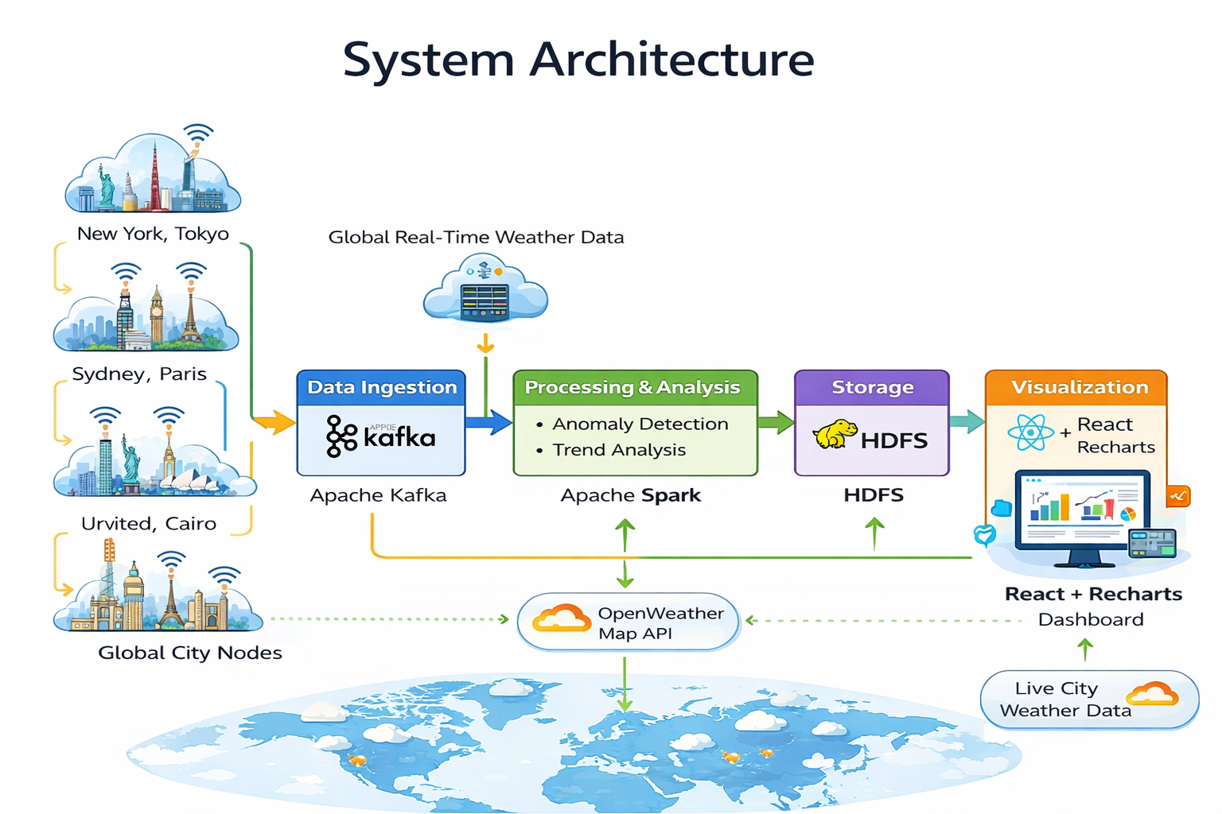

Slide 13
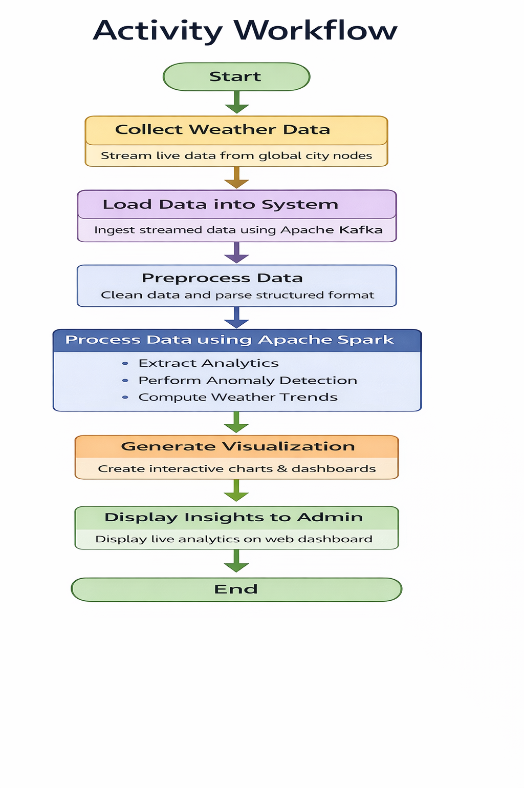

Slide 14
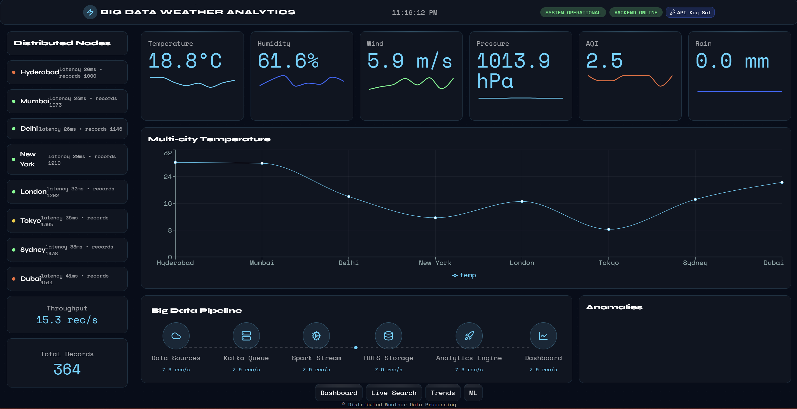
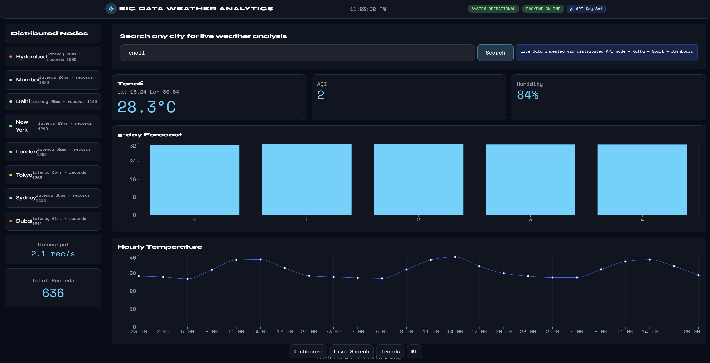
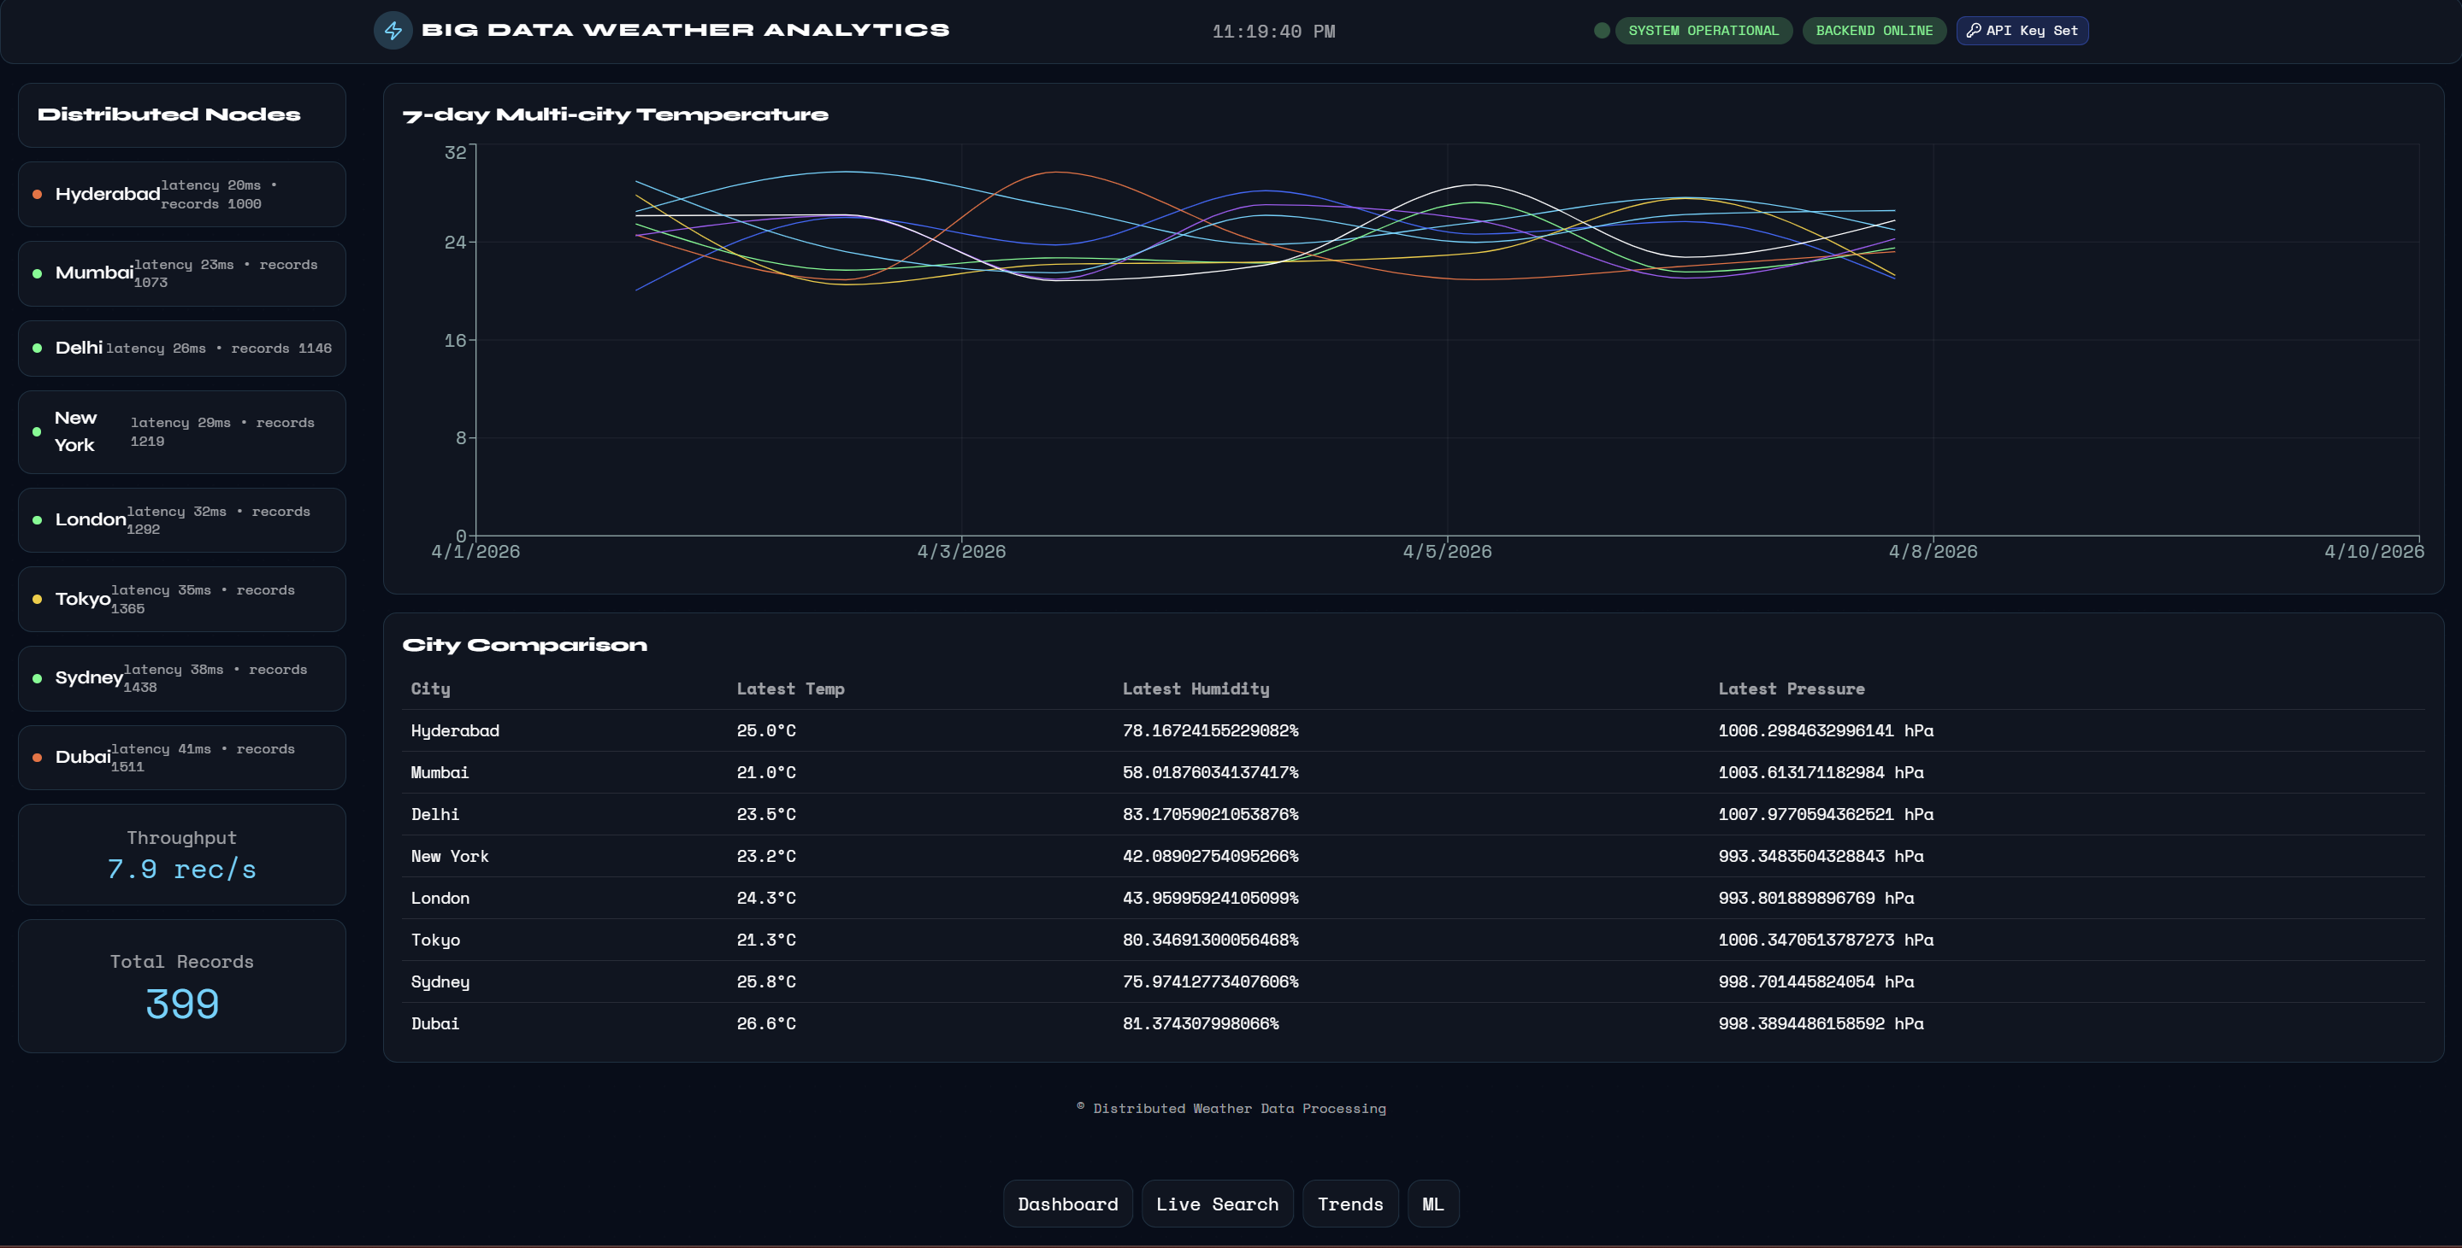
Result
Real-time log monitoring and performance metrics generated.
Traffic analysis identified top IPs, URLs, and data usage.
Error analysis detected server and client errors.
Upload detection monitored file uploads and suspicious activity.
Results visualized using interactive dashboard.

Slide 15
Conclusion
This project demonstrates how Big Data technologies can be used to process and analyze large volumes of weather data in real time.
The system collects weather data from multiple sources, processes it using distributed technologies, and displays insights through an interactive dashboard.
Using tools like Apache Kafka, Apache Spark, and HDFS, the system can efficiently handle streaming data, detect anomalies, and visualize weather trends.
This project shows how Big Data platforms can help in real-time environmental monitoring and data-driven decision making.

Slide 16
THANK YOU

